Slide 1
Financial modeling
Pei-Chun Lin
Sirina Chen
Wei-Cheng Wang
Xinxin Wang

Slide 2
Data Overview
14 columns: 1 for sequence numbering, 12 for variables and 1 for class variable.
ID column: contains unique sequence numbers
1-362 is bankrupt firms
363-12212 is non-bankrupt firms (11850 non-bankruptcy)
Class variables is for bankruptcy status: 1 is bankruptcy and 0 is non-bankruptcy.
No missing value

Slide 3
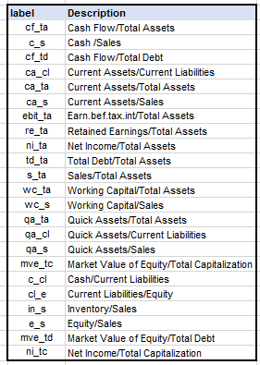
DATA OVERVIEW

Slide 4
Project Flow
Oversampling
Data Processing
Split data
Logistic Regression
Model Estimation
Correlation Analysis

Slide 5

Oversampling Using Excel
There are 11851 observations, whereas for bankrupt firms there are only 363 observations.
To create a more accurate prediction model, we have to balance two dataset.
We applied to multiply the 363 observations in bankrupt firms to 11947 observations in total with approximately 1-3% increase or decrease in each duplication by using Excel.

Slide 6

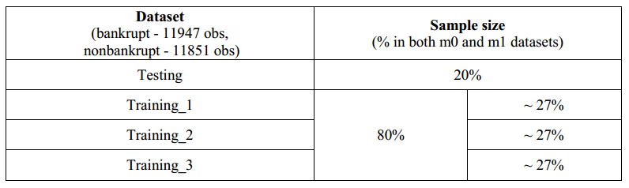
Data Processing Using Hive
1. Temporary table
2. Insert data into the temporary table
3. Create data table
4. Insert data into table from temporary table
Testing and Training Dataset
• Testing – 20%
• Training 1 – 27%
• Training 2 – 27%
• Training 3 – 27%

Slide 7
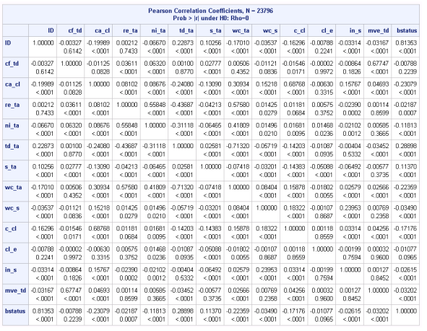
Correlation Analysis
By running this analytical method, we will be able to identify whether any multicollinearity problem is going to happen in the predictive model.
However, in the result, statistically there is no highly correlated relationship between each of the variables

Slide 8
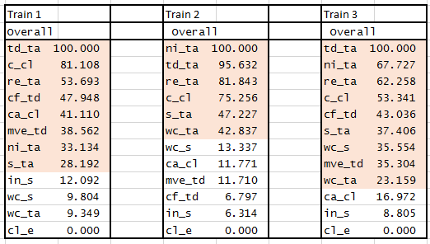
Logistic Regression
Logistic Regression is selected as a predictive model in this project, because the responding variable is binary variable.
In the training models, all models appear to be significant at 5 percent level, for training 1, 2 and 3, the p values are all <.0001.
The percentage of important variables

Slide 9
Important Variables Chosen
By looking at the output of Maximum Likelihood Estimates, we are able to find each of the significant variables while running logistic regression model in each training data. Marked 1, if the variables turn out to be significant in the model, otherwise is blank.

Slide 10
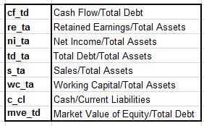
Selected points which are 2 or above, indicated that the variables have more than 50% chance of being significant in the prediction model. Final variables chosen are listed below:

Slide 11
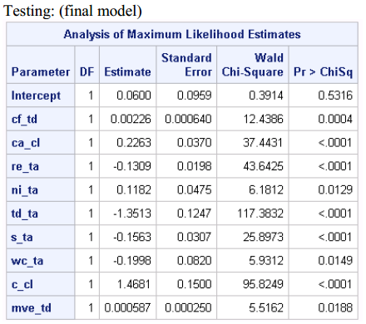
Testing model
In the maximum likelihood estimates, expect for the value on intercept, all other the variables are significant at 5% level.

Slide 12
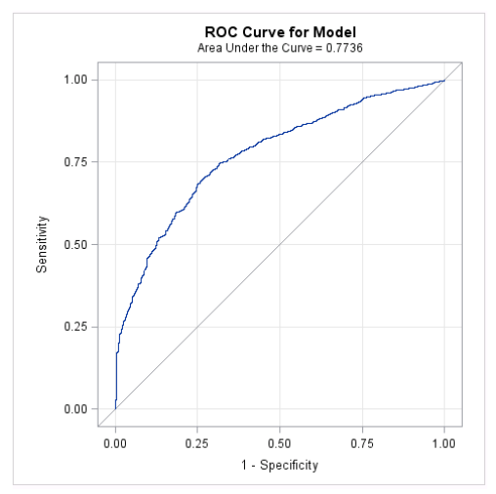

In the below ROC curve, area under the curve shows that this model is covering 0.77 of the area, which indicates that this model is an acceptable discrimination.

Slide 13

Model Estimation
misClassError is 0.3241.
The model provides approximately 68% of accuracy to the prediction.
Confusion Matrix:

Slide 14


